Slide 1
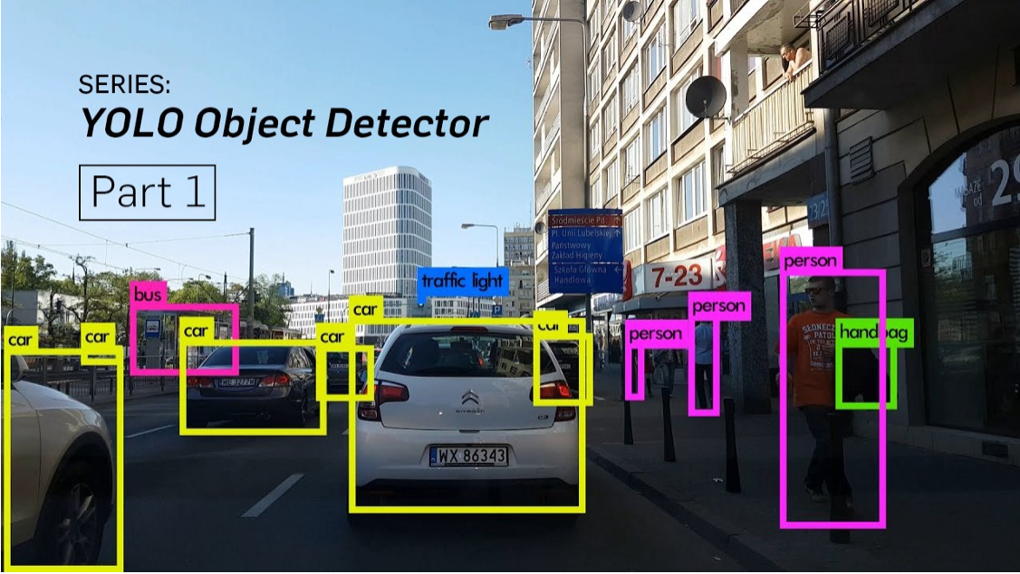
YOLOv3: An Incremental Improvement

Slide 2
What is YOLO? YOLO stands for You Only Look Once. It’s an object detector that uses features learned by a deep convolutional neural network to detect an object.
A Fully Convolutional Neural Network
YOLO makes use of only convolutional layers, making it a fully convolutional network (FCN). It has 75 convolutional layers, with skip connections and upsampling layers. No form of pooling is used, and a convolutional layer with stride 2 is used to downsample the feature maps. This helps in preventing loss of low-level features often attributed to pooling.
Interpreting the output
In YOLO, the prediction is done by using a convolutional layer (Duh…it’s a fully convolutional network, remember?) with a kernel size of
1 x 1 x (B x (5 + C))
Now, the first thing to notice is our output is a feature map. Since we have used 1 x 1 convolutions, the size of the prediction map is exactly the size of the feature map before it. In YOLO v3 (and it’s descendants), the way you interpret this prediction map is that each cell can predict a fixed number of bounding boxes.

Slide 3
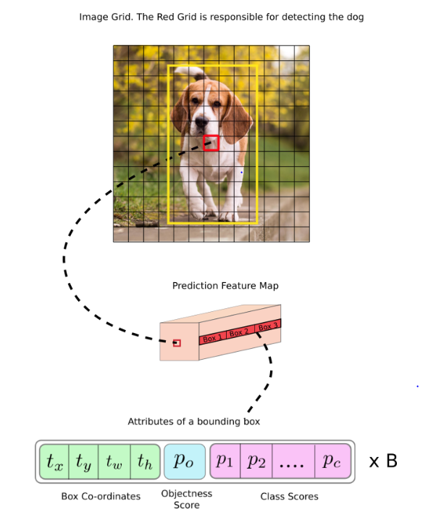
Let us consider an example below, where the input image is 416 x 416, and stride of the network is 32. As pointed earlier, the dimensions of the feature map will be 13 x 13. We then divide the input image into 13 x 13 cells.
Depth-wise, we have (B x (5 + C)) entries in the feature map. B = Bounding Boxes and Each BB predicts - (5+C) attributes
- C = No. of classes in the dataset(eg =80 in COCO- p1, p2,p3…..p80) 5 = center coordinates, the dimensions, the objectness score
Middle one
7th cell in the 7th row on the feature map (corresponding cell on the feature map) as the one responsible for detecting the dog.
Anchor Boxes
Instead, most of the modern object detectors predict log-space transforms, or simply offsets to pre-defined default bounding boxes called anchors.
The bounding box responsible for detecting the dog will be the one whose anchor has the highest IoU with the ground truth box.

Slide 4
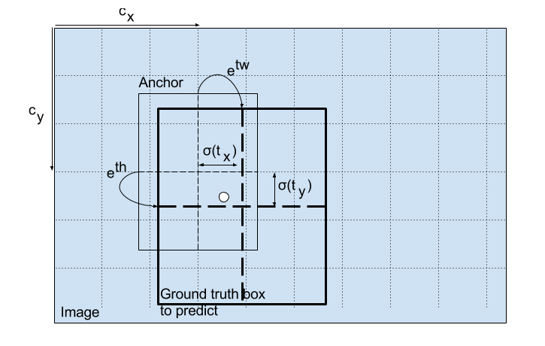
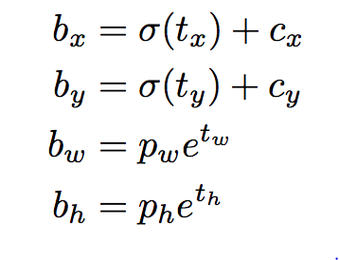
1.) Center Coordinates – tx , ty to bx ,by Notice we are running our center coordinates prediction through a sigmoid function. This forces the value of the output to be between 0 and 1
Dimensions of the Bounding Box
3.) Objectness Score
Object score represents the probability that an object is contained inside a bounding box. It should be nearly 1 for the red and the neighboring grids, whereas almost 0 for, say, the grid at the corners.
The objectness score is also passed through a sigmoid, as it is to be interpreted as a probability.
4.) Class Prediction
Each box predicts the classes the bounding box may contain using multilabel classification.
--Sigmoid
-- Binary loss function
2.) Dimensions of the Bounding Box
The dimensions of the bounding box are predicted by applying a log-space transform to the output and then multiplying with an anchor.

Slide 5
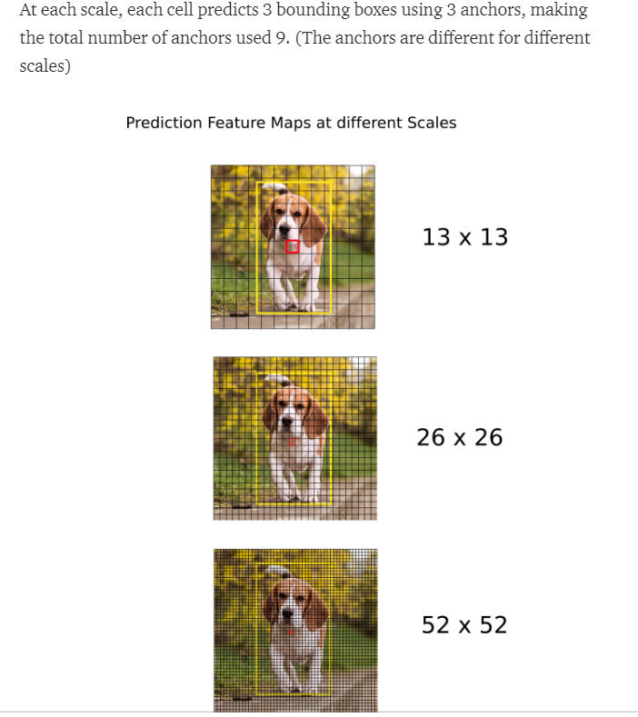
Prediction across different scales. YOLO v3 makes prediction across 3 different scales. The detection layer is used make detection at feature maps of three different sizes, having strides 32, 16, 8 respectively. This means, with an input of 416 x 416, we make detections on scales 13 x 13, 26 x 26 and 52 x 52.
Output Processing
For an image of size 416 x 416, YOLO predicts
((52 x 52) + (26 x 26) + 13 x 13)) x 3 = 10647 bounding boxes. However, in case of our image, there’s only one object, a dog.
How do we reduce the detections from 10647 to 1?

Slide 6
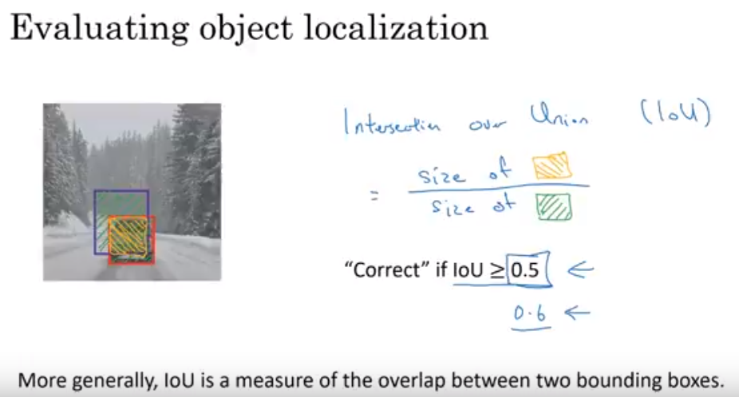
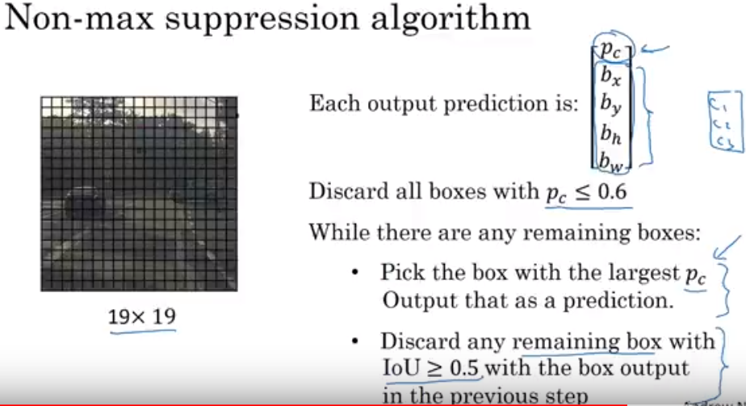
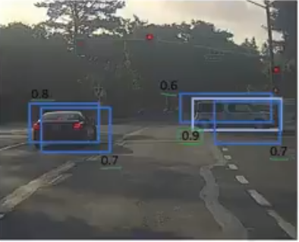
Thresholding by Object Confidence First, we filter boxes based on their objectness score. Generally, boxes having scores below a threshold are ignored.
Non-maximum Suppression NMS intends to cure the problem of multiple detections of the same image. For example, all the 3 bounding boxes of the red grid cell may detect a box or the adjacent cells may detect the same object.

Slide 7
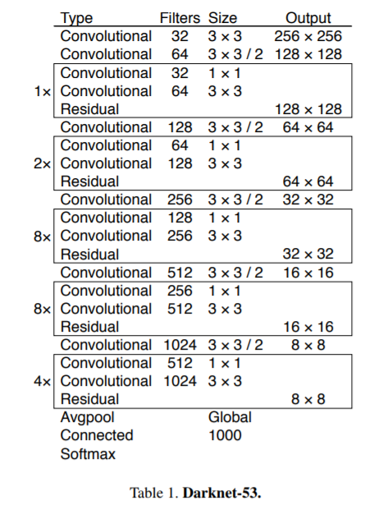
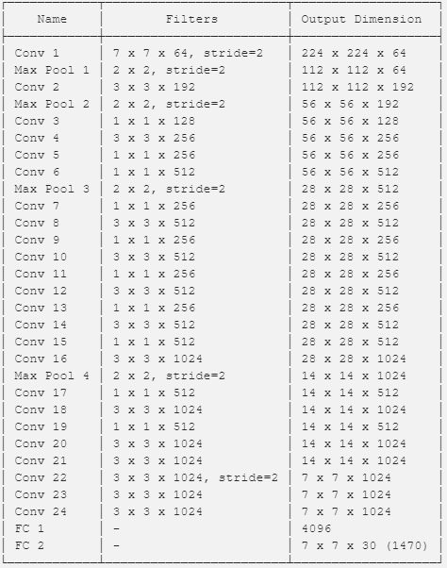
YOLO v3 from scratch in PyTorch Part 1 : Creating the layers of the network architecture Part 2 : Implementing the the forward pass of the network Part 3 : Objectness score thresholding and Non-maximum suppression Part 4 : Designing the input and the output pipelines
Darknet-19

Slide 8
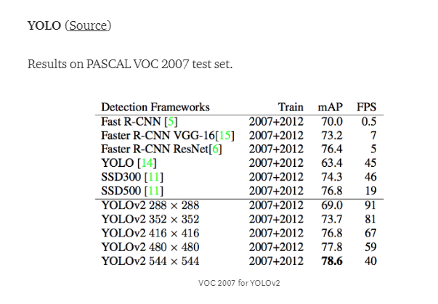
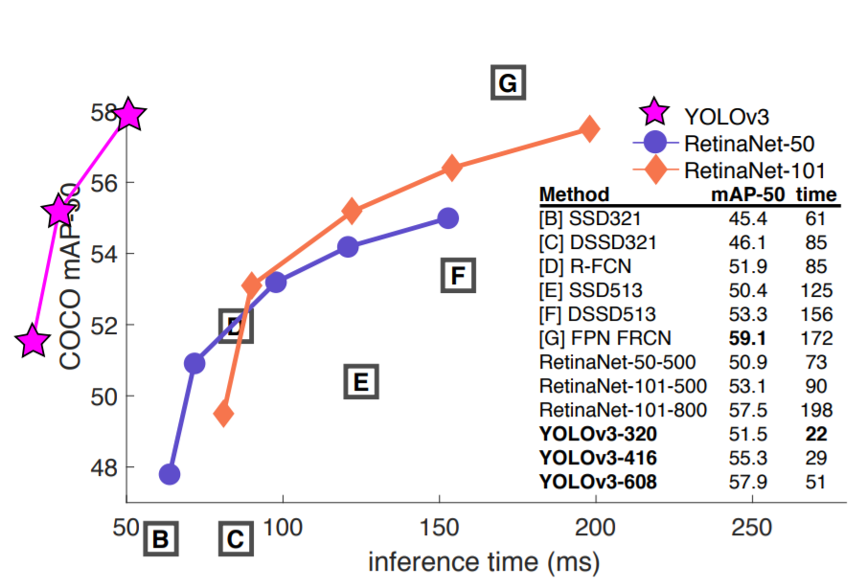
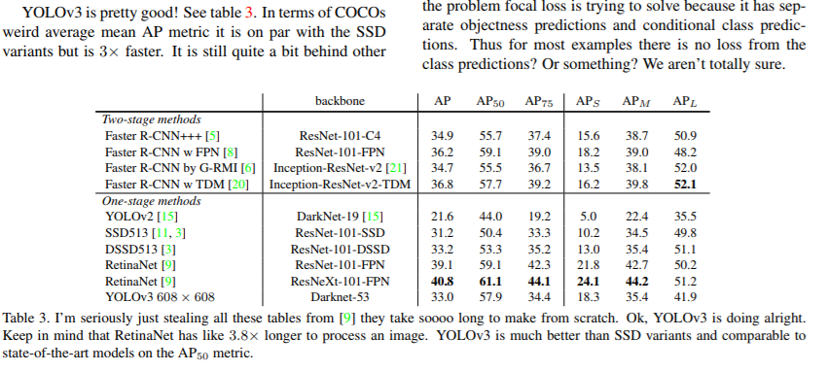
Speed/Accuray – Made on AP(50) metric

Slide 9
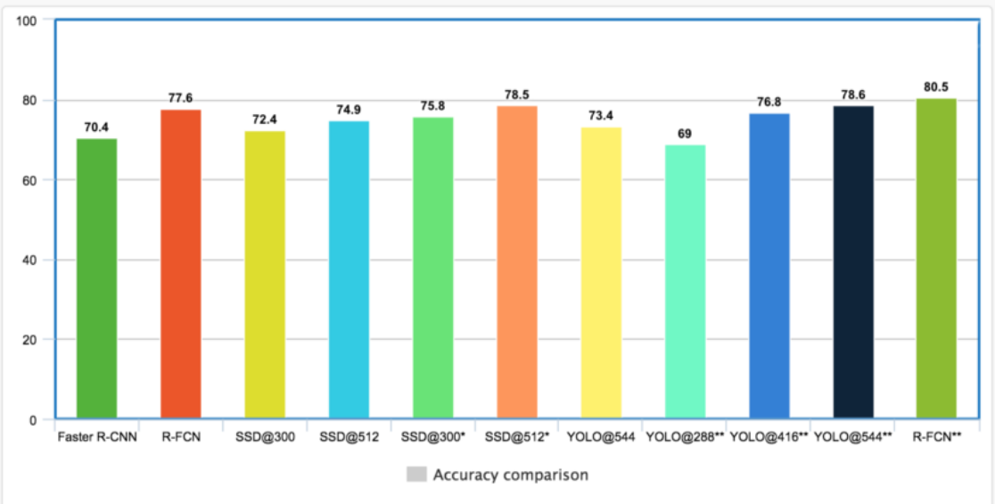
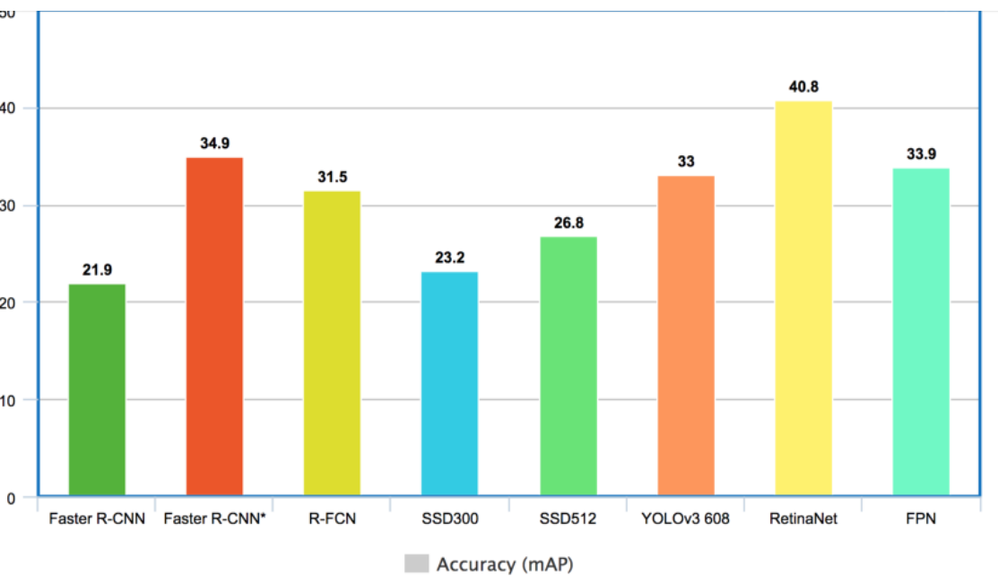
Accuracy
Pascal VOC-2012
MS COCO

Slide 10
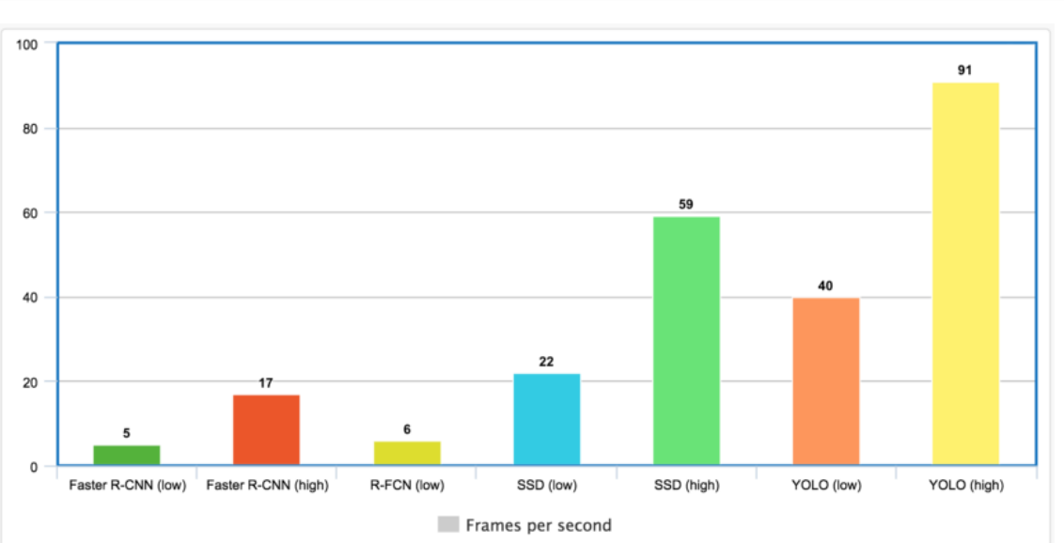
Pascal VOC-2012- Frame Per Second

Slide 11
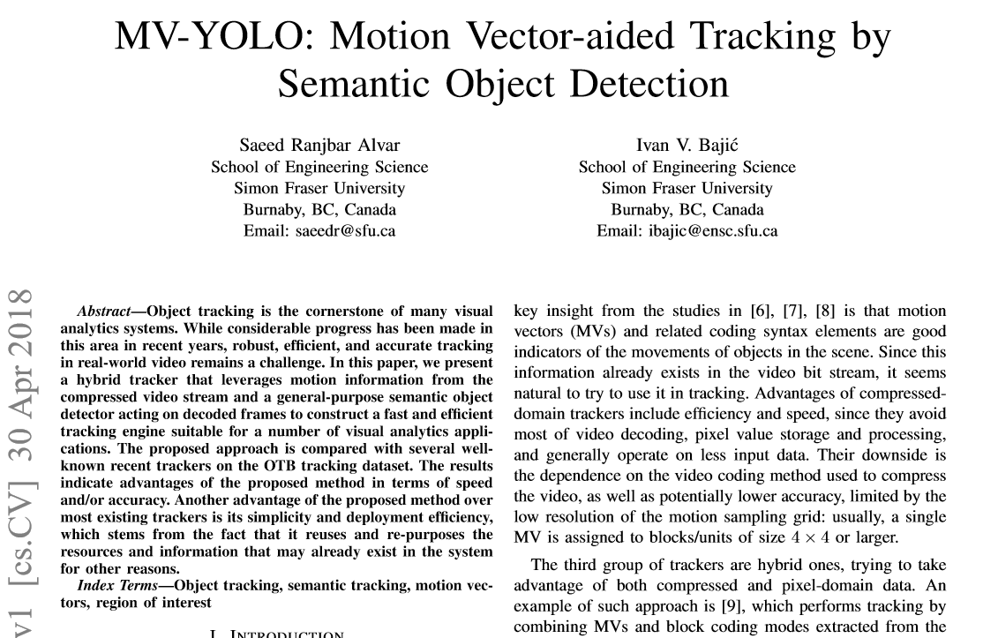

Slide 12
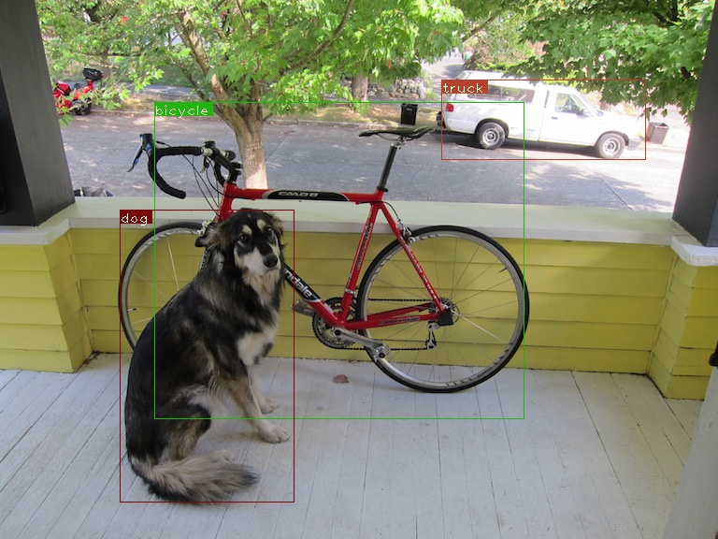
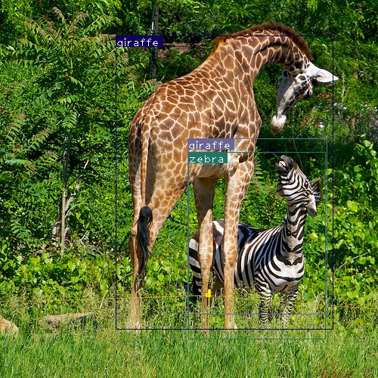

Slide 13
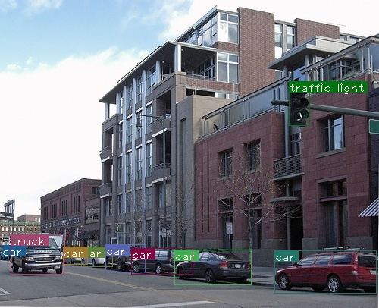
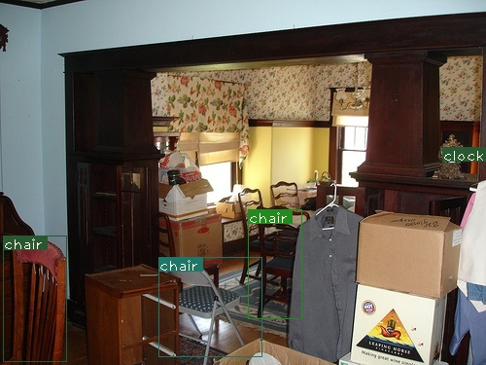

Slide 14
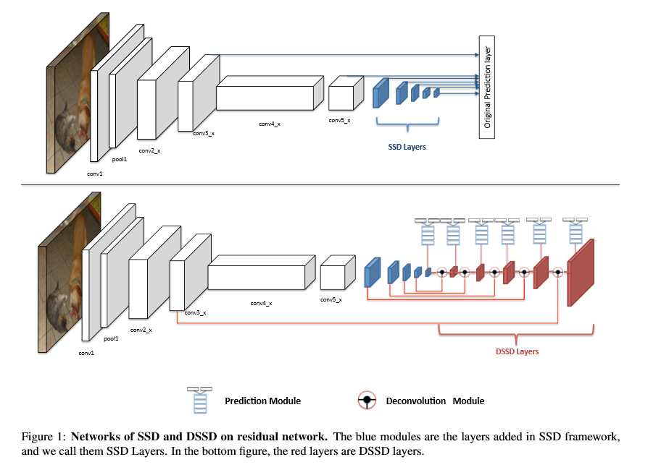
SSD and DSSD Architecture---

Slide 15
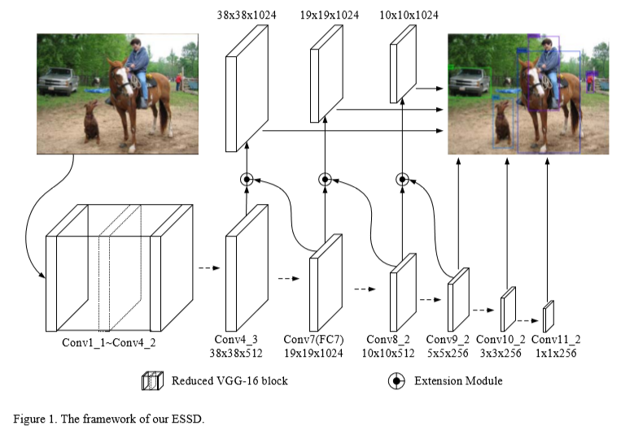
ESSD – Extend the shallow part of Single Shot MultiBox Detector via Convolutional Neural Network

Slide 16
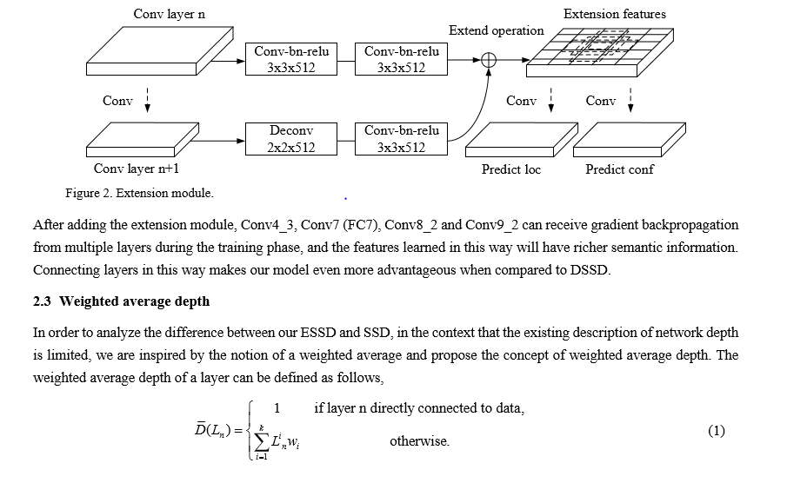

Slide 17
